Slide 1
Revealing Parallel Scans and Reductions in Recurrences through Function Reconstruction

Slide 2
Background
The approaches in earlier efforts were mostly template-based.
Drawback:cannot handle variables with mutual dependences except for linear cases.
More recent techniques for extracting scan/reduction patterns in recurrences are mostly search-based.
Fisher:aggressive symbolic analysis to search for closed-form compositions of the loop body functions. ----works for loops that can be sliced into first-order recurrences.
Raychev:use symbolic execution to derive the combined function at runtime. ----too expensive.
Farzan:use an SMT solver to search for the combined function. ----depends on underlying solver.

Slide 3
Our Work
We observe that in many cases, the combined function across iterations for a recurrence loop usually have a fixed geometric shape and can be precisely represented by one or more input-output pairs.
verify its type (or shape) at compile time.
Then we generate a sampling-and-reconstruction strategy for the combined function based on the function type.
Four function type:
Linear Functions
Rectified-linear Functions
Finite-state Functions
Multivariate Functions

Slide 4
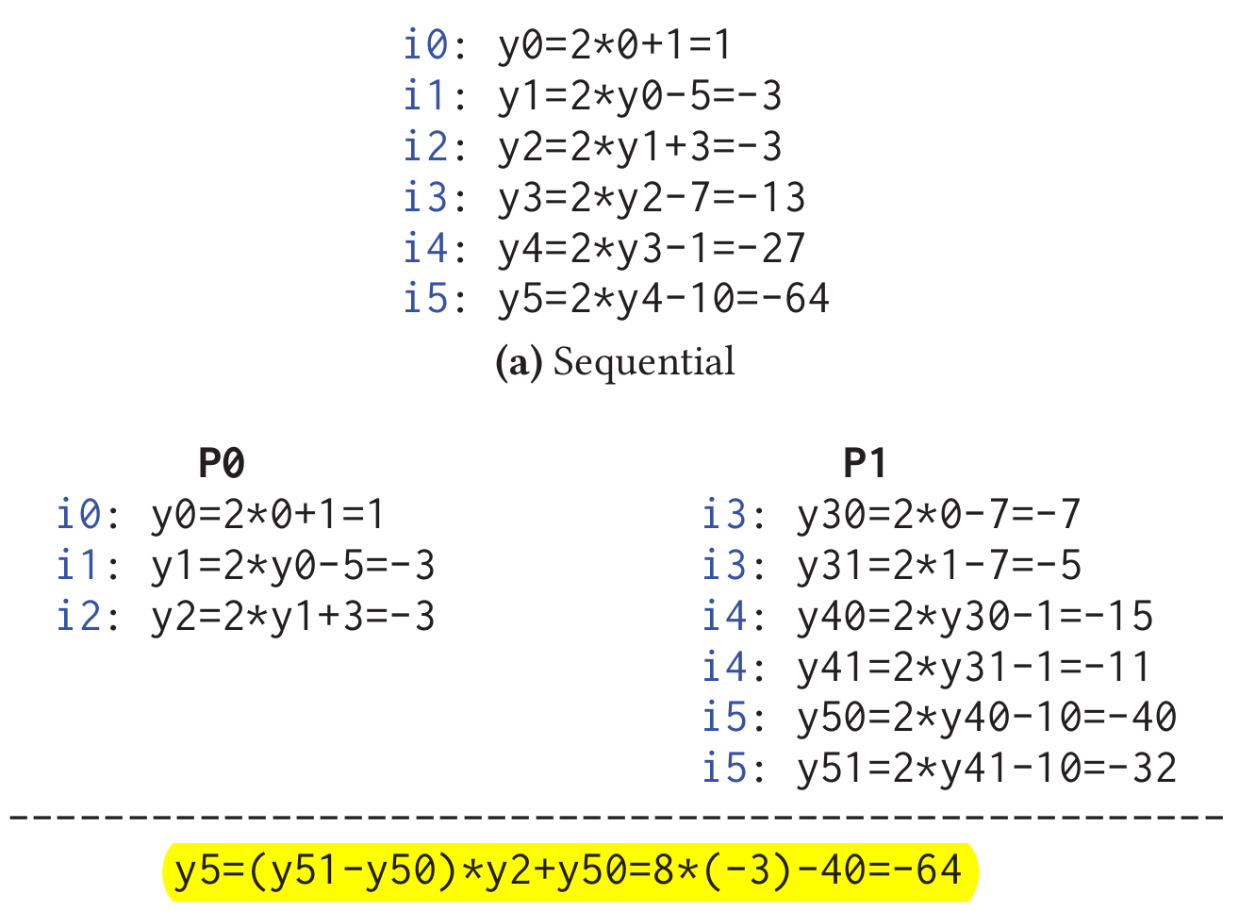


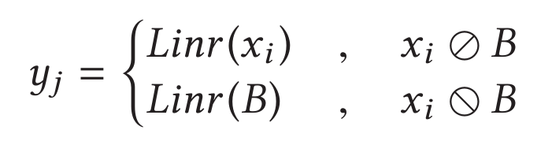
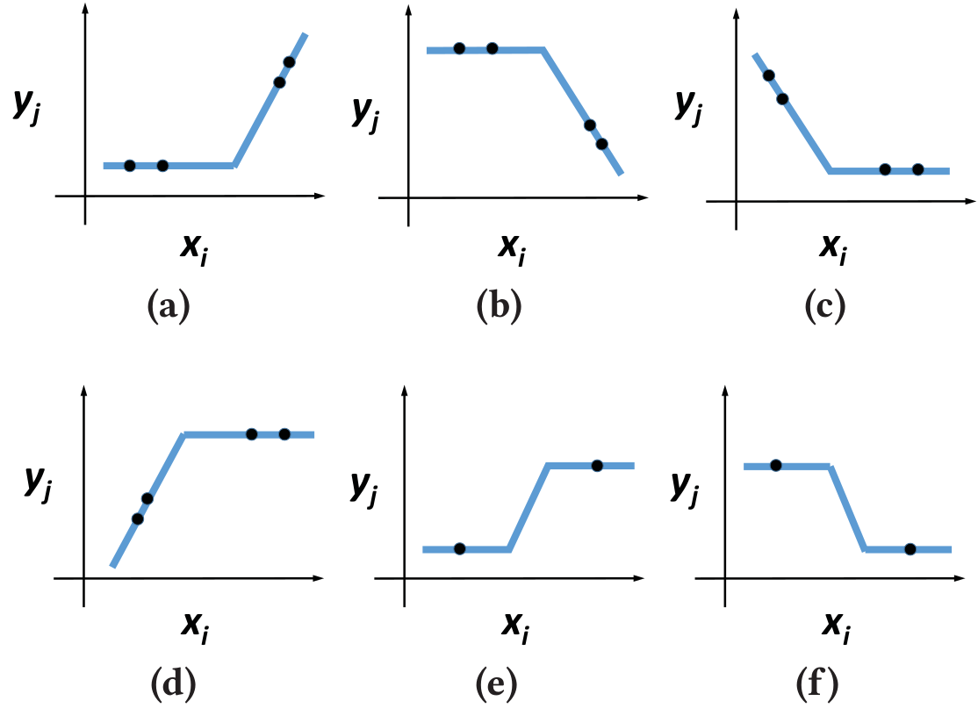
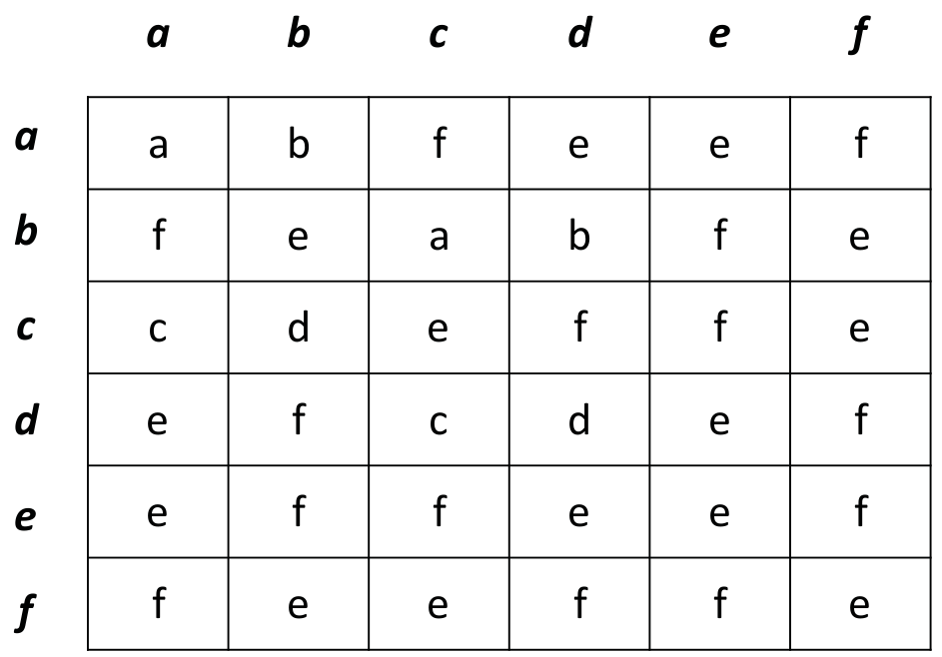
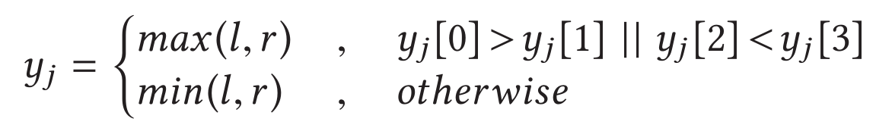


Sampling and Reconstruction
Linear Functions：
Rectified-linear functions:
For e and f, get more information about the middle piece (e.g.,the middle piece or the extended line passes origin and has slope of 1 or −1)
slope=1:
pass origin:

Slide 5
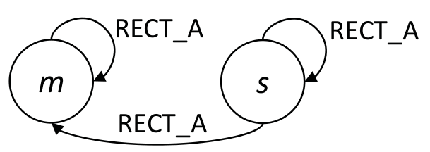
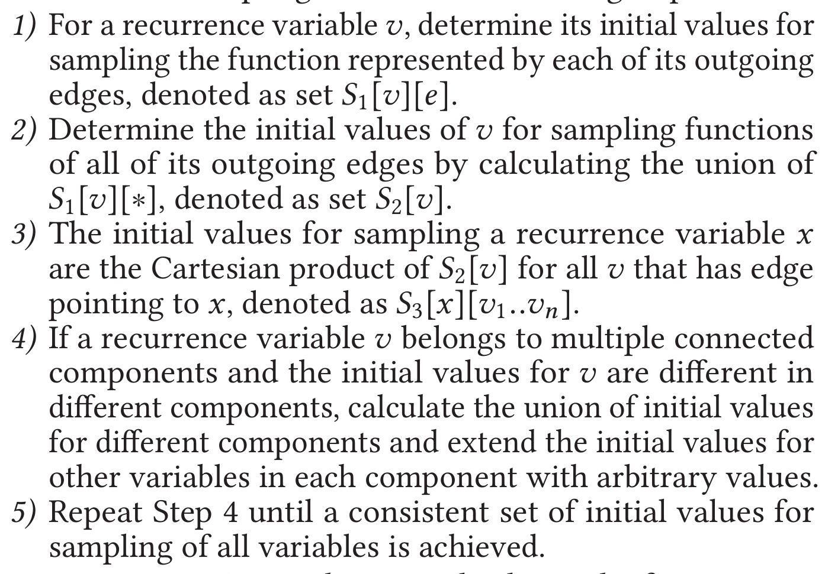
Sampling and Reconstruction
Finite-state Functions：
simply enumerate all the possible input states and the function is the one-to-one mapping between the inputs and outputs.
Multivariate Functions：

Slide 6
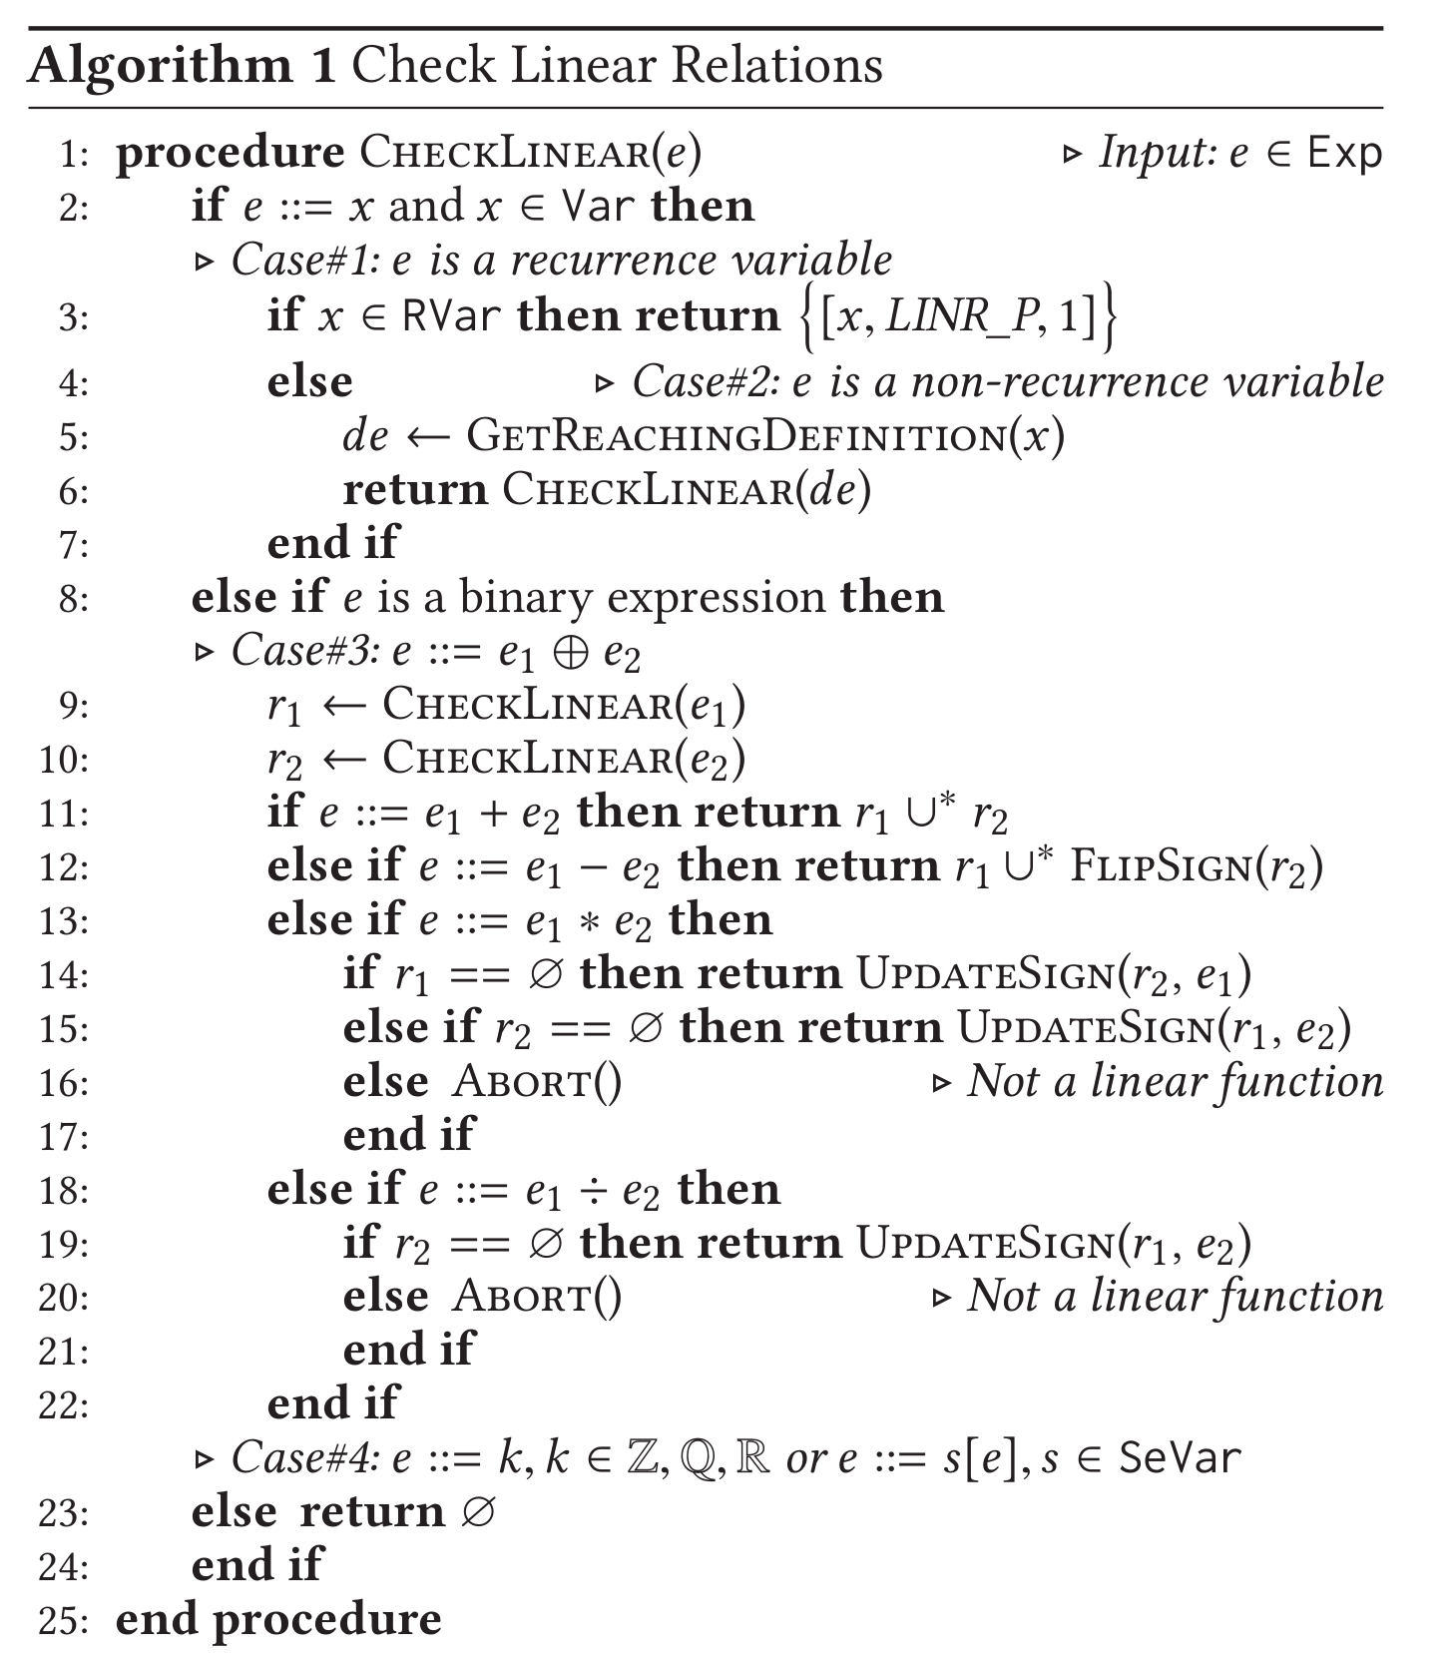
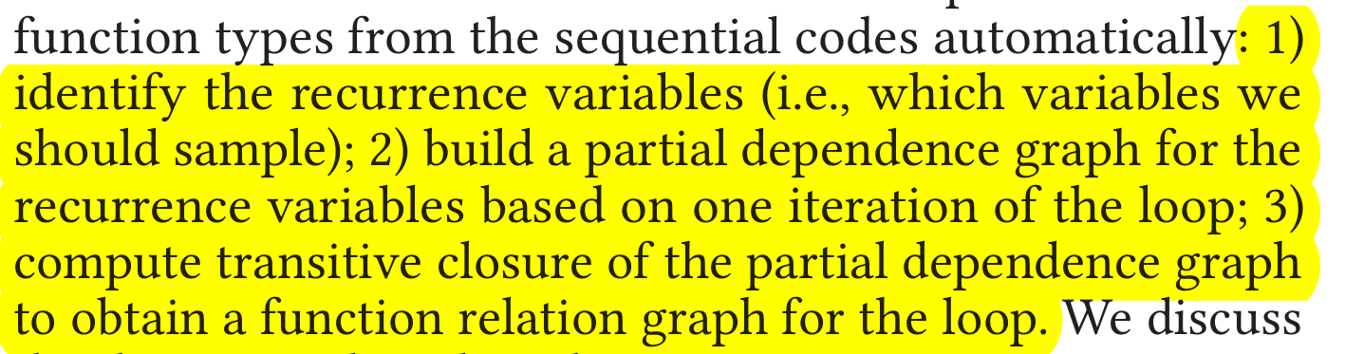
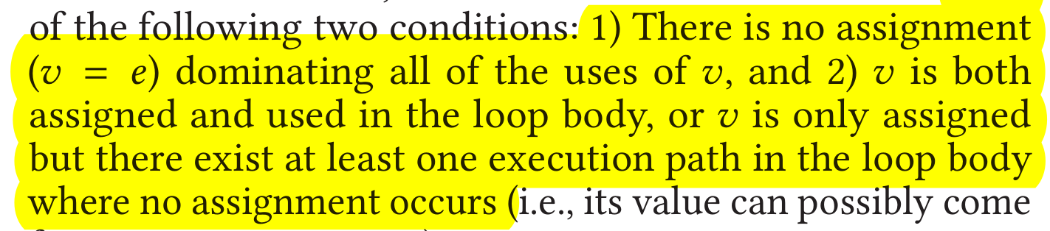
Inferring Function Types
Identify recurrence variables:
Verifying Linear Relation:

Slide 7
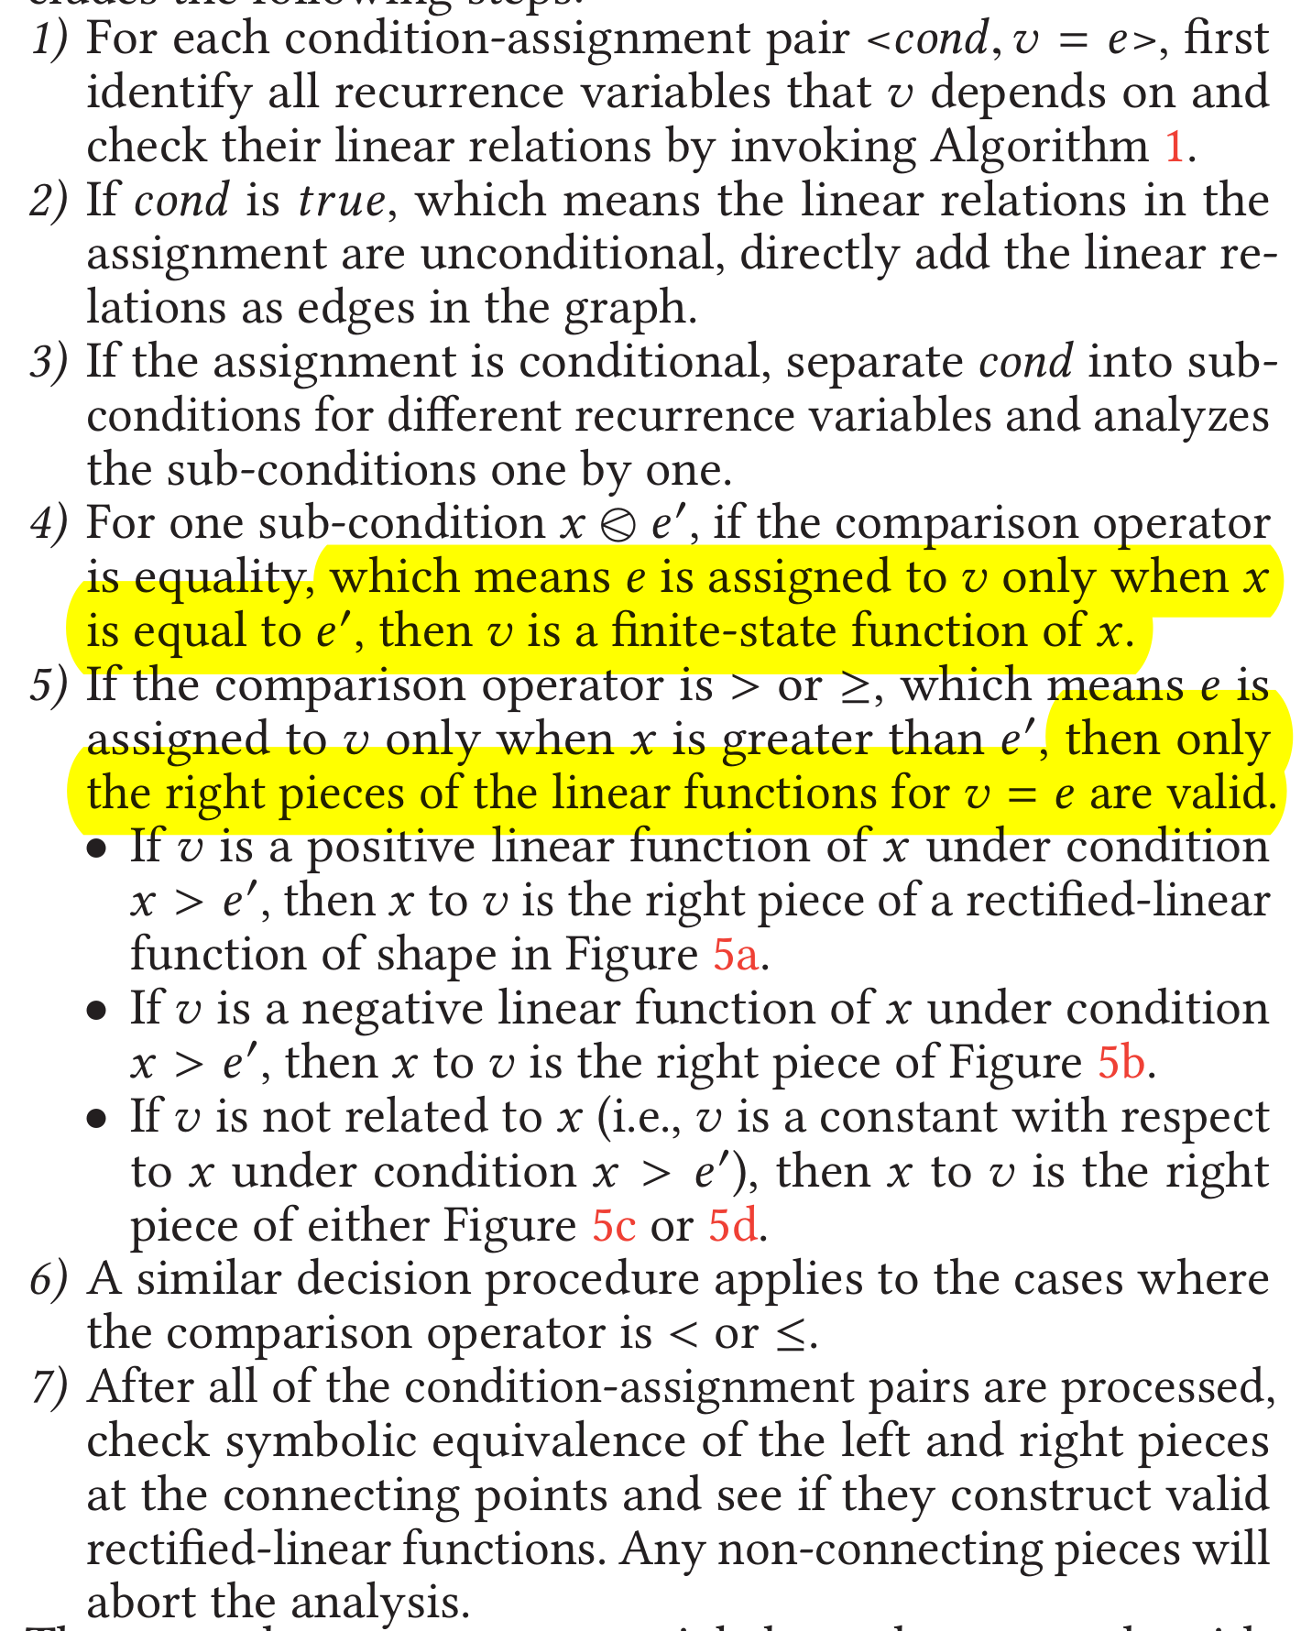
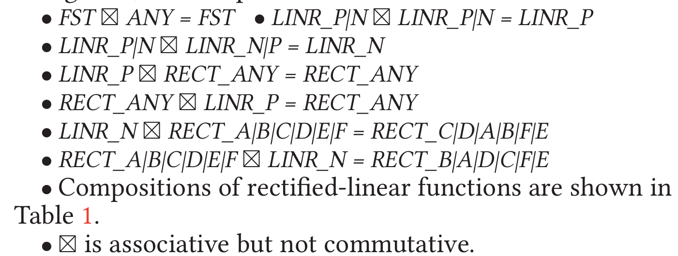
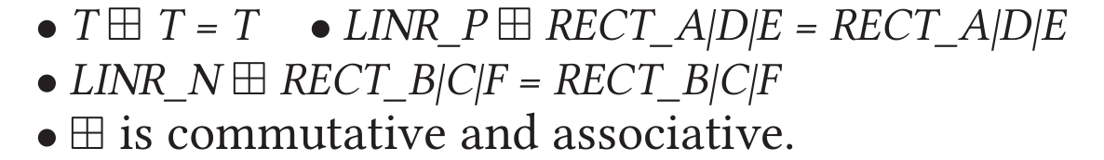
Inferring Function Types(2)
Building Partial Dependence Graph:
Reasoning across Iterations:
composition：
merge：

Slide 8
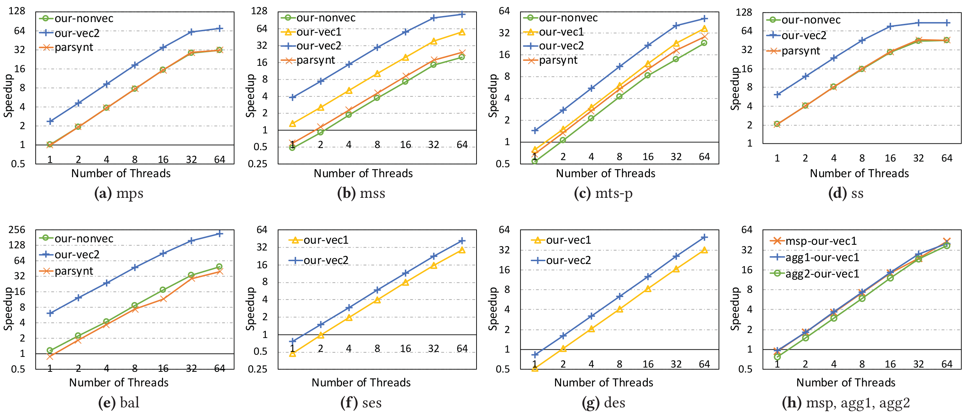
Evaluation
Experimental Setup：Intel Xeon Phi 7250 processor, 68 cores 1.4GHz. compiled with Intel ICC 17.0.4.
mps: maximum prefix sum.
mss: maximum segmented sum.
mts-p: maximum tail sum with position returned.
ss: second smallest.
bal: balanced-().
ses: single exponential smoothing.
des: double exponential smoothing.
msp: maximum segmented product.
agg1:counts the events between "PUSH" and
"PULL".
agg2 counts thenumber of operations in each session that is determined by whether the time interval between two consecutive operations are smaller than a threshold.

